Slide 1



KTC CFS C.24 (Bill C-92)
Valerie Spence, BA, MSW
CFS Project Lead

Slide 2
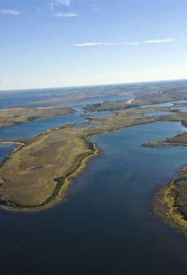

KTC C. 24 (BILL C-92) PROJECT BACKGROUND:
The Keewatin Tribal Council Bill C-92 Project received initial funding from ISC, Community Well-Being and Jurisdictions Initiative program. Funding was designated for Bill C-92 community engagement project in 7 of the 11 KTC communities. The 7 participating communities are as follows:
Bunibonibee Cree Nation
Fox Lake Cree Nation
God’s Lake Narrows First Nation
Manto Sipi First Nation
Sayisi Dene First Nation
War Lake First Nation
York Factory First Nation

Slide 3
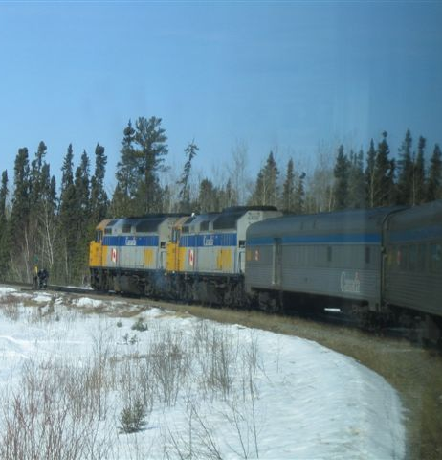
KTC C. 24 (BILL C-92) PROJECT BACKGROUND:
The following 4 communities chose to seek independent Bill C-92 funding. These 4 communities are welcome to join the KTC Bill C-92 project at any time and will continue to be invited to participate in the project's activities and events.
Barren Lands First Nation
Northlands Denesuline First Nation
Shamattawa First Nation
Tataskweyak Cree Nation

Slide 4
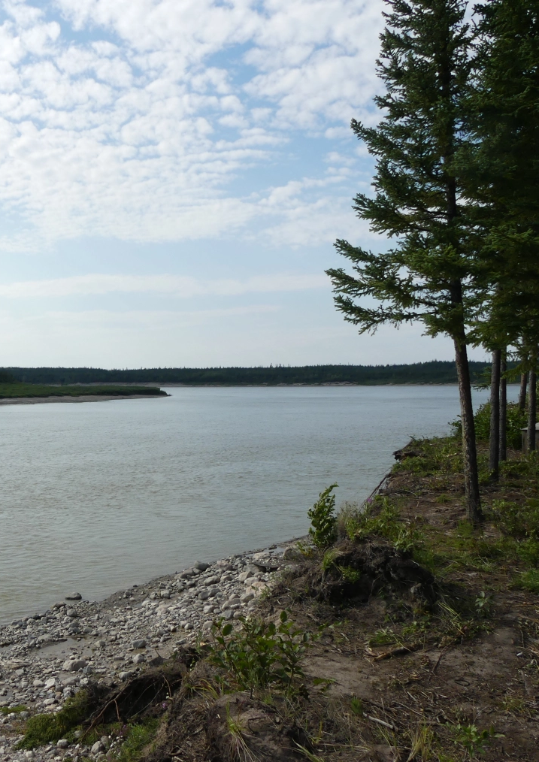
KEEWATIN TRIBAL COUNCIL BILL C-92 RESOLUTIONS
March 5, 2020 – Chief Forum on Bill C-92 – Victoria Inn and Conference Centre, Winnipeg, MB
Resolution supporting KTC First Nations Unified Response to Bill C-92, an Act Respecting First Nations, Inuit and Metis children, youth and families.
August 11-13, 2020 – Semi-Annual General Assembly – Thompson Legion, Thompson, MB
Resolution #6 – Support for an Indigenous Governing Body for the KTC First Nations under the Act Respecting First Nations, Inuit and Metis children, youth and families.
April 22, 2021 – Virtual Chiefs Meeting
Resolution supporting Keewatin Tribal Council’s C-92 response.

Slide 5

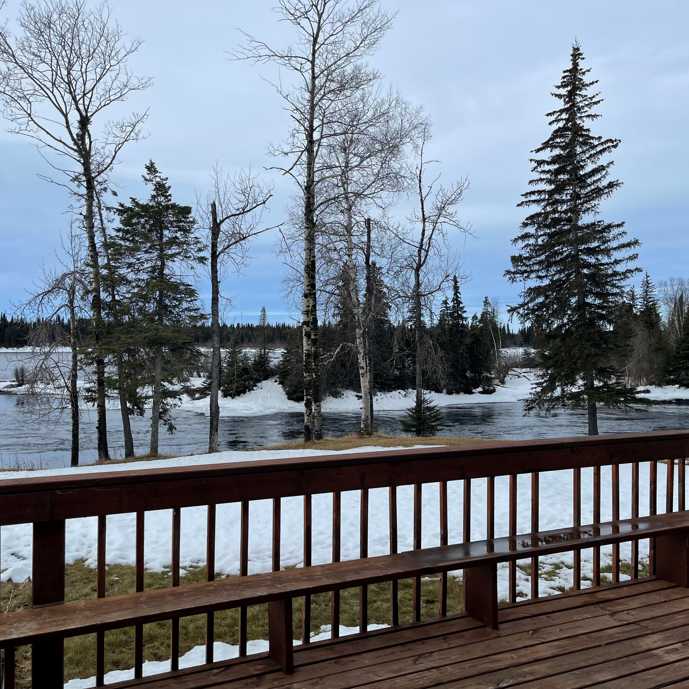
Individual Band Council Resolutions as per April 22, 2021 Resolution
“Be it further resolved, that the C-92 Project Staff secure Band Council Resolutions from each First Nation to support the Keewatin Tribal Council C-92 process”.
Individual Band Council Resolutions have been received from the following:
Bunibonibee Cree Nation
Fox Lake Cree Nation
Mantou Sakahigan Cree Nation
Manto Sipi Cree Nation
York Factory Cree Nation
War Lake First Nation
Not yet signed:
Sayisi Dene First Nation

Slide 6
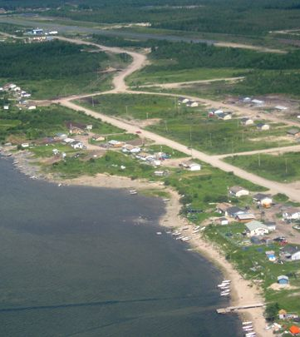
SECTION 12 NOTICES
In accordance with section 12 of An Act respecting First Nation, Inuit and Métis children, youth and families, S.C. 2019, c. 24, KTC has informed service providers that before taking any significant measure involving the children and families of the above noted communities, the service providers must provide notice to Keewatin Tribal Council.
The following Nations have signed and provided KTC with Section 12 Notices that have been distributed to all relevant agencies:
Bunibonibee Cree Nation
Fox Lake Cree Nation
Manto Sipi Cree Nation
York Factory Cree Nation
Mantou Sakahigan Cree Nation
War Lake First Nation
Not yet signed:
Sayisi Dene First Nation

Slide 7
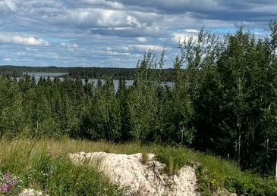
FUNDING
The KTC C. 24 (Bill C-92) Project receives funding from:
Community Well-Being and Jurisdiction Initiative (CWJI) Program
2020-2021 Funding
December 2020 – KTC received notification from ISC CWJI that the collaborative community KTC C. 24 (Bill C-92) project will receive $2,000,000 for the 2020-2021 fiscal year.
2021-2022 Funding
The project did not receive any additional funds for this fiscal year as engagement events/activities began towards the end of the fiscal year. Therefore, the majority of the budget from the 2020-2021 fiscal year remained.
2022-2023 Funding
End-of-year reports are being submitted to ISC CWJI for the 2021-2022 fiscal year and proposal for new funding for the 2022-2023 fiscal year.

Slide 8
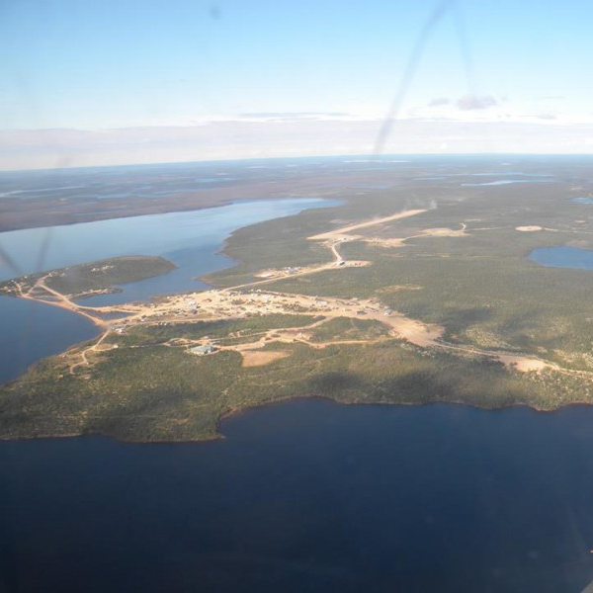
STEERING COMMITTEE/ELDERS ADVISORY
The KTC CFS Steering Committee is comprised of a representative from each of the participating Nations.
Committee Members were appointed by the Chief and Council of their respective Nation and is made primarily up of Councillor’s holding the CFS portfolio.
The Committee meets once per month for 2-3 days and meetings are planned 6 months in advance.
The purpose of the Steering Committee is to assist in the development of child and family services Law based on the vision, needs, customs, traditions, and values of Member Nations of Keewatin Tribal Council within the framework of self-determination.

Slide 9
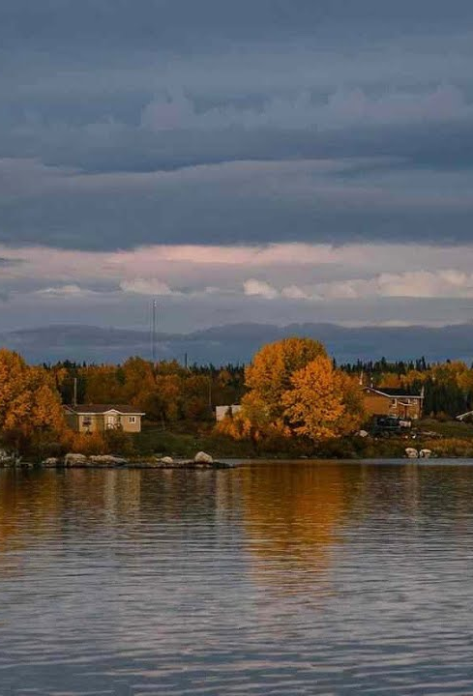
Specific Areas of Responsibility
The Steering Committee will perform the following key duties:
Attend and participate in all scheduled meetings.
Prepare for meetings.
Respectful code of conduct as per Keewatin Tribal Council policy, including toward other Steering Committee members, Chief and Council, legal counsel, and citizens.
Work with the legal team to develop a Keewatin Tribal Council CFS Law for recommendation to the Keewatin Tribal Council Leadership.
Engage in and participate in meetings with citizens of Member Nations.
Provide regular updates to the Keewatin Tribal Council Leadership.
Additional duties as may be delegated to the Committee by the Keewatin Tribal Council Leadership, as per April 22, 2021, Resolution:
  Develop a child and family services law;
  Determine the scope of the child and family services law;
  Determine how services will be delivered and by whom;
  Authorize an Indigenous governing body to act on behalf of the Keewatin Tribal Council children, youth, and families; and
  Confirm the mandate of the Indigenous Governing Body.

Slide 10
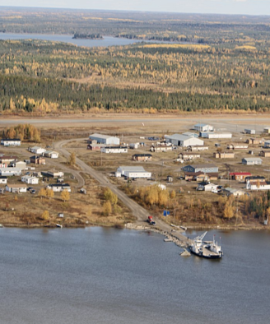
STEERING COMMITTEE MEMBERS/ELDER REPRESENTATIVES
Bunibonibee Cree Nation
Councillor Marion Wood – Steering Committee Member
Don Robinson – Community Elder Representative
Mantou Sakahigan Cree Nation
Councillor Phillip Kanabee – Steering Committee Member
Manto Sipi Cree Nation
Councillor Dennis McKay – Steering Committee Member (September 2022-March 2023)
Councillor Roger Ross – Steering Committee Member (April 2023)
Moses Okimaw – Community Elder Representative
Fox Lake Cree Nation
Councillor Sophie Lockhart – Steering Committee Member
Sayisi Dene First Nation
Vacant – Steering Committee Member
War Lake First Nation
Councillor Elijah Garson – Steering Committee Member
York Factory Cree Nation
Councillor Wayne Redhead – Steering Committee Member

Slide 11
Leadership and Management
Community
Chiefs in Assembly
Executive Council of Chiefs
Chief Executive Officer
CFS Project Lead
Administrative Assistant

Slide 12
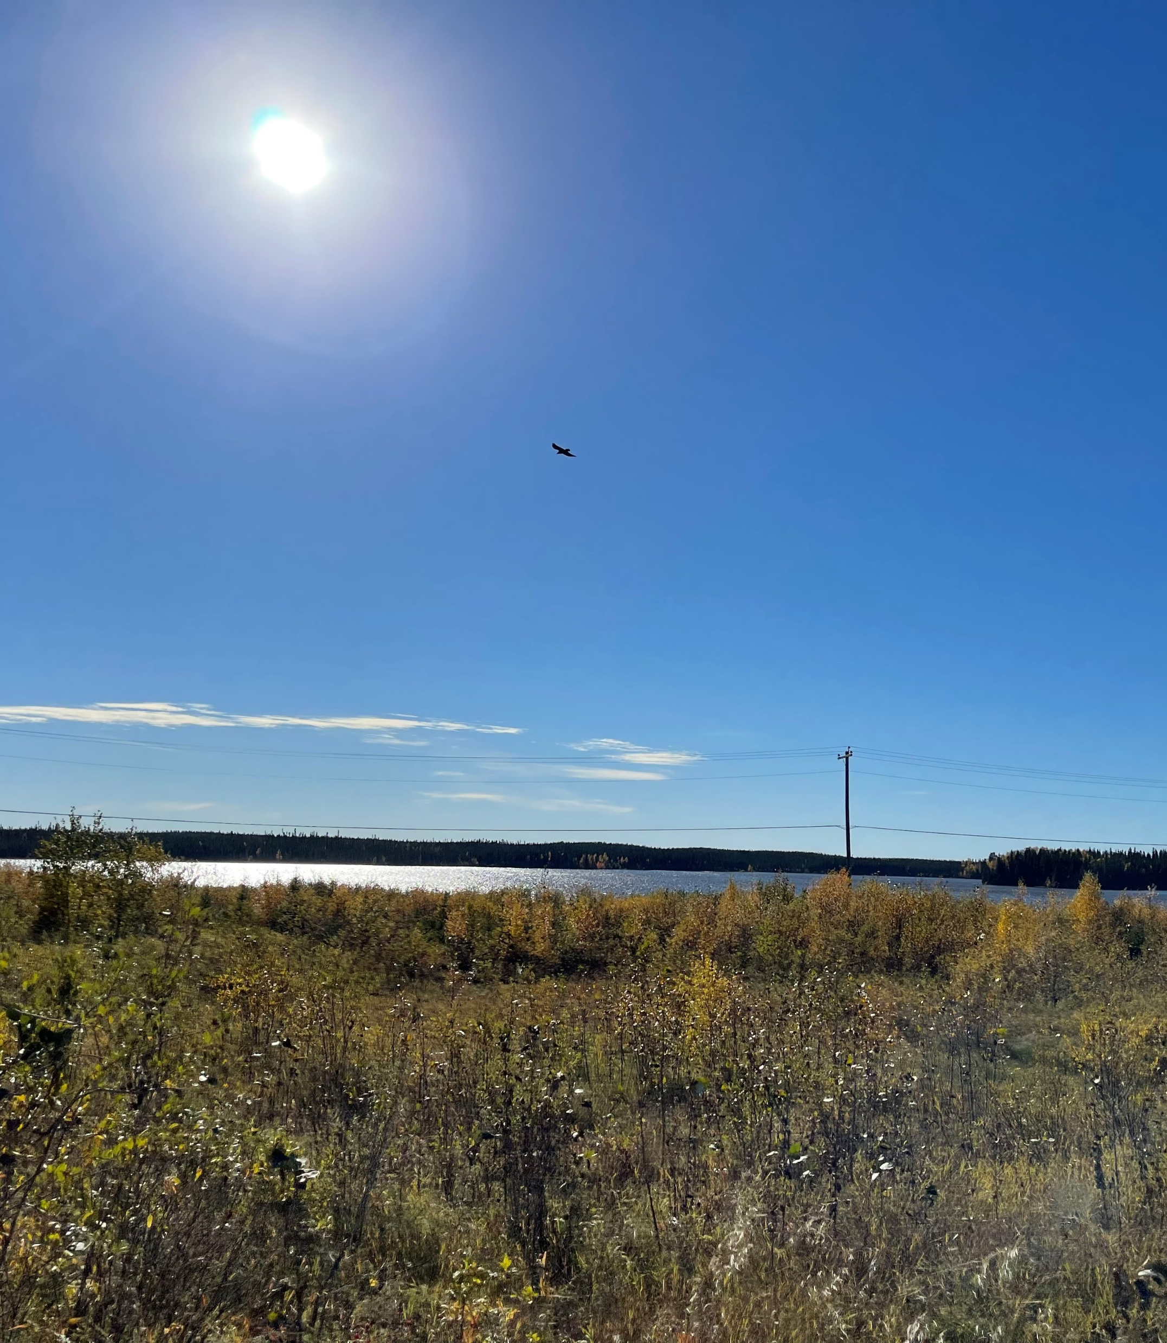
HUMAN RESOURCES
C. 24 (Bill C-92) Positions (filled)
CFS Project Lead – Valerie Spence, BA, MSW
CFS Project Assistant – Amanda Ouskan
Research Coordinator – Susan Flett, BSW
War Lake Community Liaison – Burman Kennedy
York Factory Community Liaison – Southwind Redhead
Fox Lake Community Liaison – Payge Beardy
C. 24 (Bill C-92) Position (unfilled)
Project Engagement Coordinator
CFS Team Lead
Community Liaisons
  Bunibonibee Cree Nation
  Mantou Sakihigan Cree Nation
  Manto Sipi Cree Nation
  Sayisi Dene First Nation

Slide 13
C. 24 Organizational Chart
CFS Project Lead
Administrative Assistant
Elders Advisory
Steering Committee
Legal
Team Lead
Research Coordinator
Project Engagement Coordinator
Liaison Barren Lands
Liaison Bunibonibee
Liaison Northlands
Liaison God’s Lake
Liaison Sayisi
Liaison Manto Sipi
Liaison Fox Lake
Liason Shamattawa
Liaison Tataskweyak
Liaison War Lake
Liaison York Factory

Slide 14

C. 24 (Bill C-92) CONFERENCE SERIES
Community engagement to gather information to assist in defining C. 24 Principles and sections of C. 24 legislation.
Results from Break-out Questions were compiled from all 3 Conferences and shared with legal team.

Slide 15

Conference One
June 28-29, 2023
Focus: Defining 1st Principle of the ACT
  Best Interests of the Child
Theme: “BRIDGING THE STRENGTHS OF THE PAST FOR THE BEST INTERESTS OF THE CHILD”
Victoria Inn and Conference Centre – Winnipeg, MB
Keynotes:
  Hon. Murray Sinclair
  Dr. Cindy Blackstock
10 representatives from each participating Nation – Total: 90-125/day.
Representatives invited from all KTC Nations.
KTC/Northern Authority/Awasis/ISC
Break-out community engagement sessions:
  What is your vision of how we want to provide care for our children and families?
  What strengths from the past can we bring to benefit our families/communities today?
  How can we make our communities healthier

Slide 16
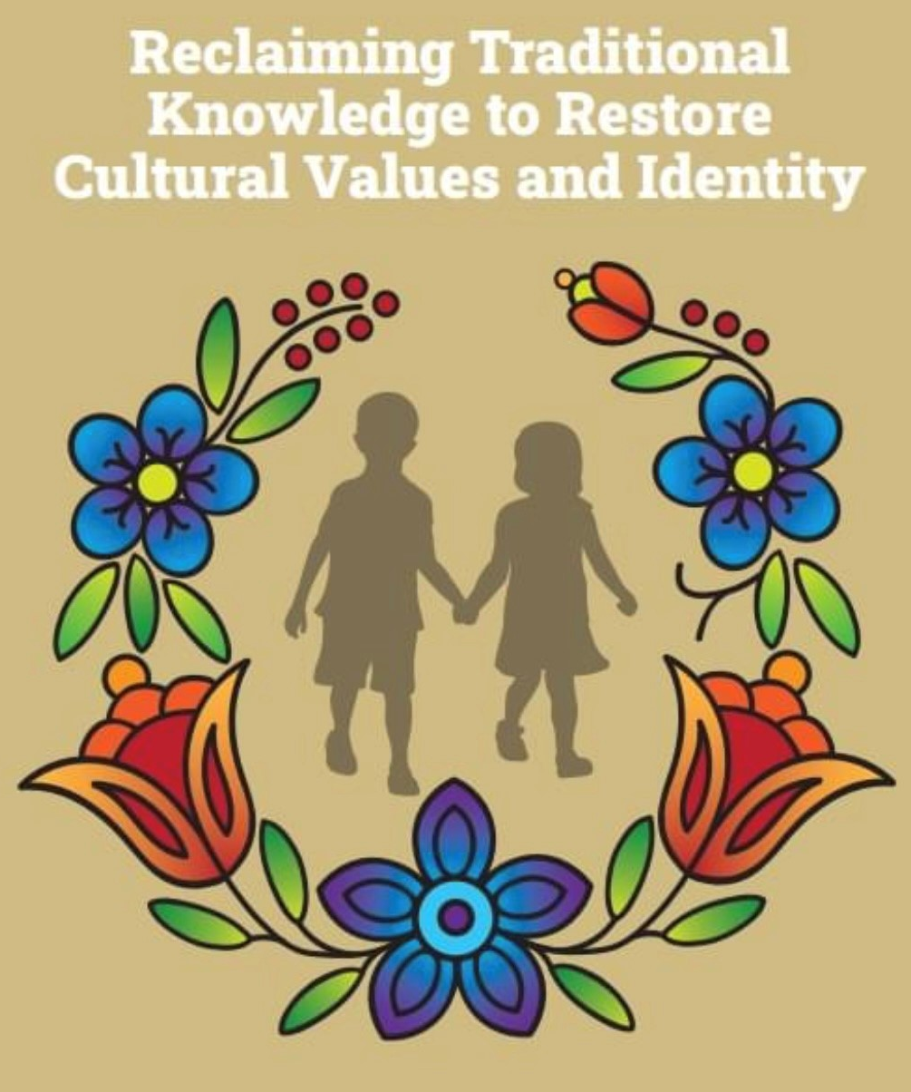
Conference Two
October 24, 25, 26, 2023
Focus: Defining 2nd Principle of the ACT
  Cultural Continuity
Theme: “RECLAIMING TRADITIONAL KNOWLEDGE TO RESTORE CULTURAL VALUES AND IDENTITY”
Venue: Best Western Plus, Winnipeg, MB
Speakers:
  Legal – 2nd Principle - Cultural Continuity
  Dr. Stewart Hill – Cree Culture and History
  Dr. Jennie Wastesicoot – CFS Jurisdiction/History
  Ernie Bussidor – Dene Culture and History
  Awasis/NA – C. 24 (Bill C-92)/CFS
12 representatives from each participating community – Total: 100-135/day.
Representative invited from other communities.
KTC/Northern Authority/Awasis/ISC representatives.
Break-out community engagement sessions:
  Prior to colonization:
    How were the children cared for? Who would care for children if the parents were unable to? How were disputes handled within the family? What role did the community play for disputes that could not be resolved in the family?
  How does the Nation define “relations”/”kinship”?

Slide 17
Conference Three
March 8, 9, 10, 2023
Focus: Defining 2nd Principle of the ACT
  Substantive Equality
Theme: “RECLAIMING THE SACRED BALANCE, RESTORING WAHKOTOWIN-EHLELOT’INA”
Venue: Victoria Inn and Conference Centre, Winnipeg, MB
Speakers:
  Legal – 3rd Principle – Substantive Equality
  Wayne Christian (Former Chief) – Sushwap Nation C. 24 Process
  Georgina Berg (York Factory) – Churchill/Ininew Cutlure History
  U of Alberta – Wahkohtowin Law development
  U of Victoria – Indigenous Law Development
12 representatives from each participating community – Total: 100-135/day.
Representative invited from all KTC communities
KTC/Northern Authority/Awasis/ISC representatives
Break-out community engagement sessions:
  What does “substantive equality” mean to you?
  How can we ensure that all children have a voice in the child welfare system?
  What would substantive equality look like in terms of child welfare service delivery?

Slide 18
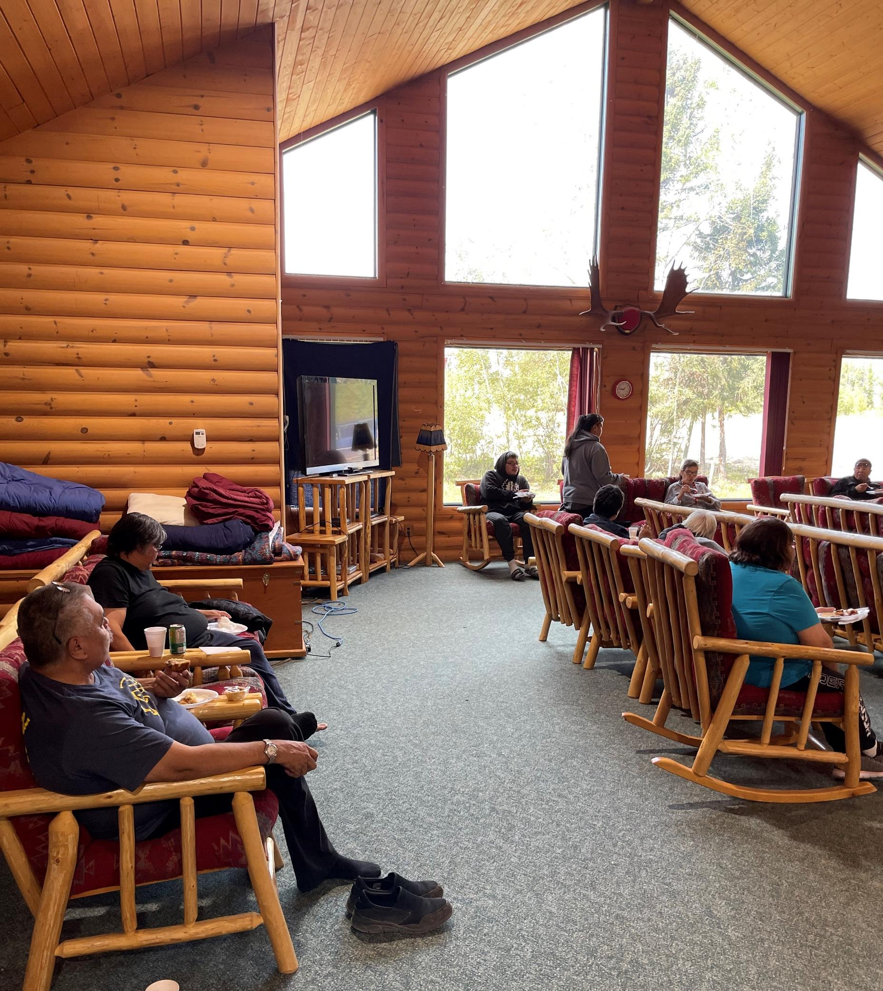
COMMUNITY ENGAGEMENT ACTIVITIES
July 19-20, 2022 – Mantou Sakahigan Introductory C. 24 Community Engagement – God’s Lake Narrows, MB
July 26-27, 2022 – Fox Lake Introductory C. 24 Community Engagement – Fox Lake Band Office, Fox Lake, MB
August 25-26, 2022 – War Lake Introductory C. 24 Community Engagement – War Lake, MB
September 27-28, 2022 – York Factory Chief and Council Meeting and Introductory C. 24 Community Engagement – York Factory, MB
October 6, 2022 – Bunibonibee Chief, Council and Introductory C. 24 Community Engagement – Bunibonibee Cree Nation, MB
October 11-12, 2022 – Pusikowak Iskwewak Conference (hosted by Fox Lake) – Victoria Inn and Conference Centre, Winnipeg, MB
December 6, 7, 8, 2022 – KTC Men’s Gathering – Radisson Hotel, Winnipeg, MB

Slide 19
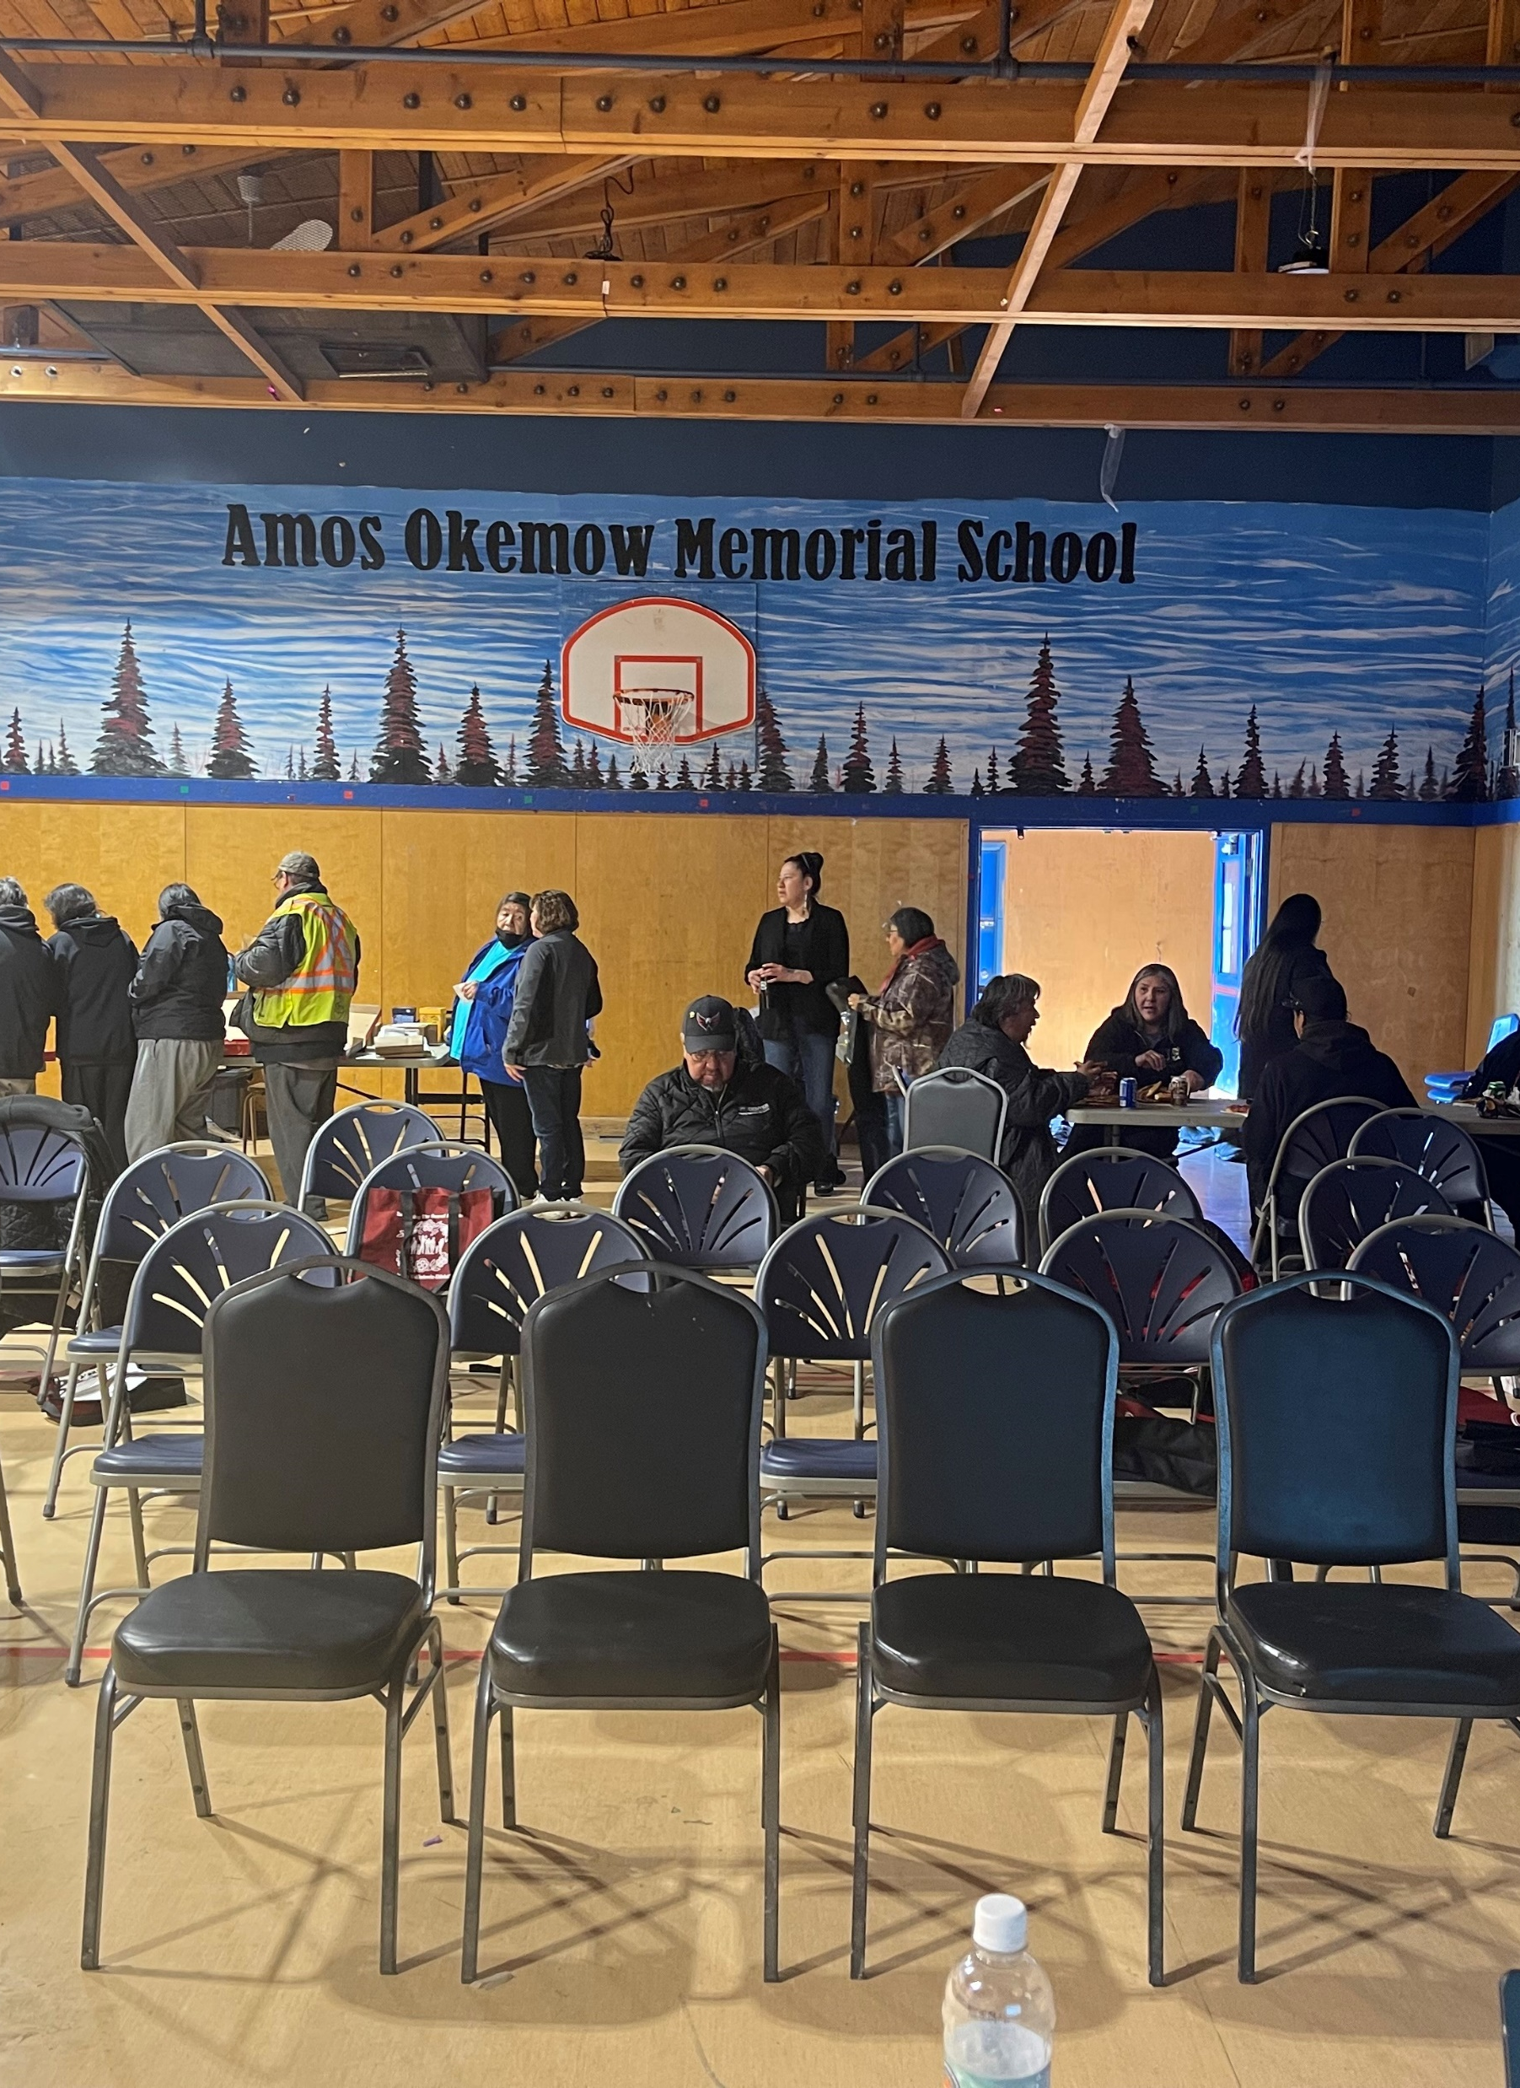
COMMUNITY ENGAGEMENT ACTIVITIES
December 13, 2023 – Churchill Off-reserve Introductory C. 24 Community Engagement – Churchill, MB
February 6-10, 2023 – KTC Youth Introductory C. 24 Engagement Gathering – Churchill Multi-plex, Churchill, MB
  Invited 3 youth from the 7 participating Nations.
February 16, 2023 – Thompson Off-reserve Introductory C. 24 Community Engagement, Ma Mow We Tak Friendship Centre, Thompson, MB
March 3-4, 2023 – KTC Tribal Days – Thompson, MB
March 23, 2023 – University of Manitoba Social Work Student Introductory C. 24 Session – Thompson, MB
April 12, 2023 – Manto Sipi Chief & Council and Introductory C. 24 Community Engagement – Manto Sipi, MB
May 9-11, 2023 – Awasis Staff Conference – Regina

Slide 20
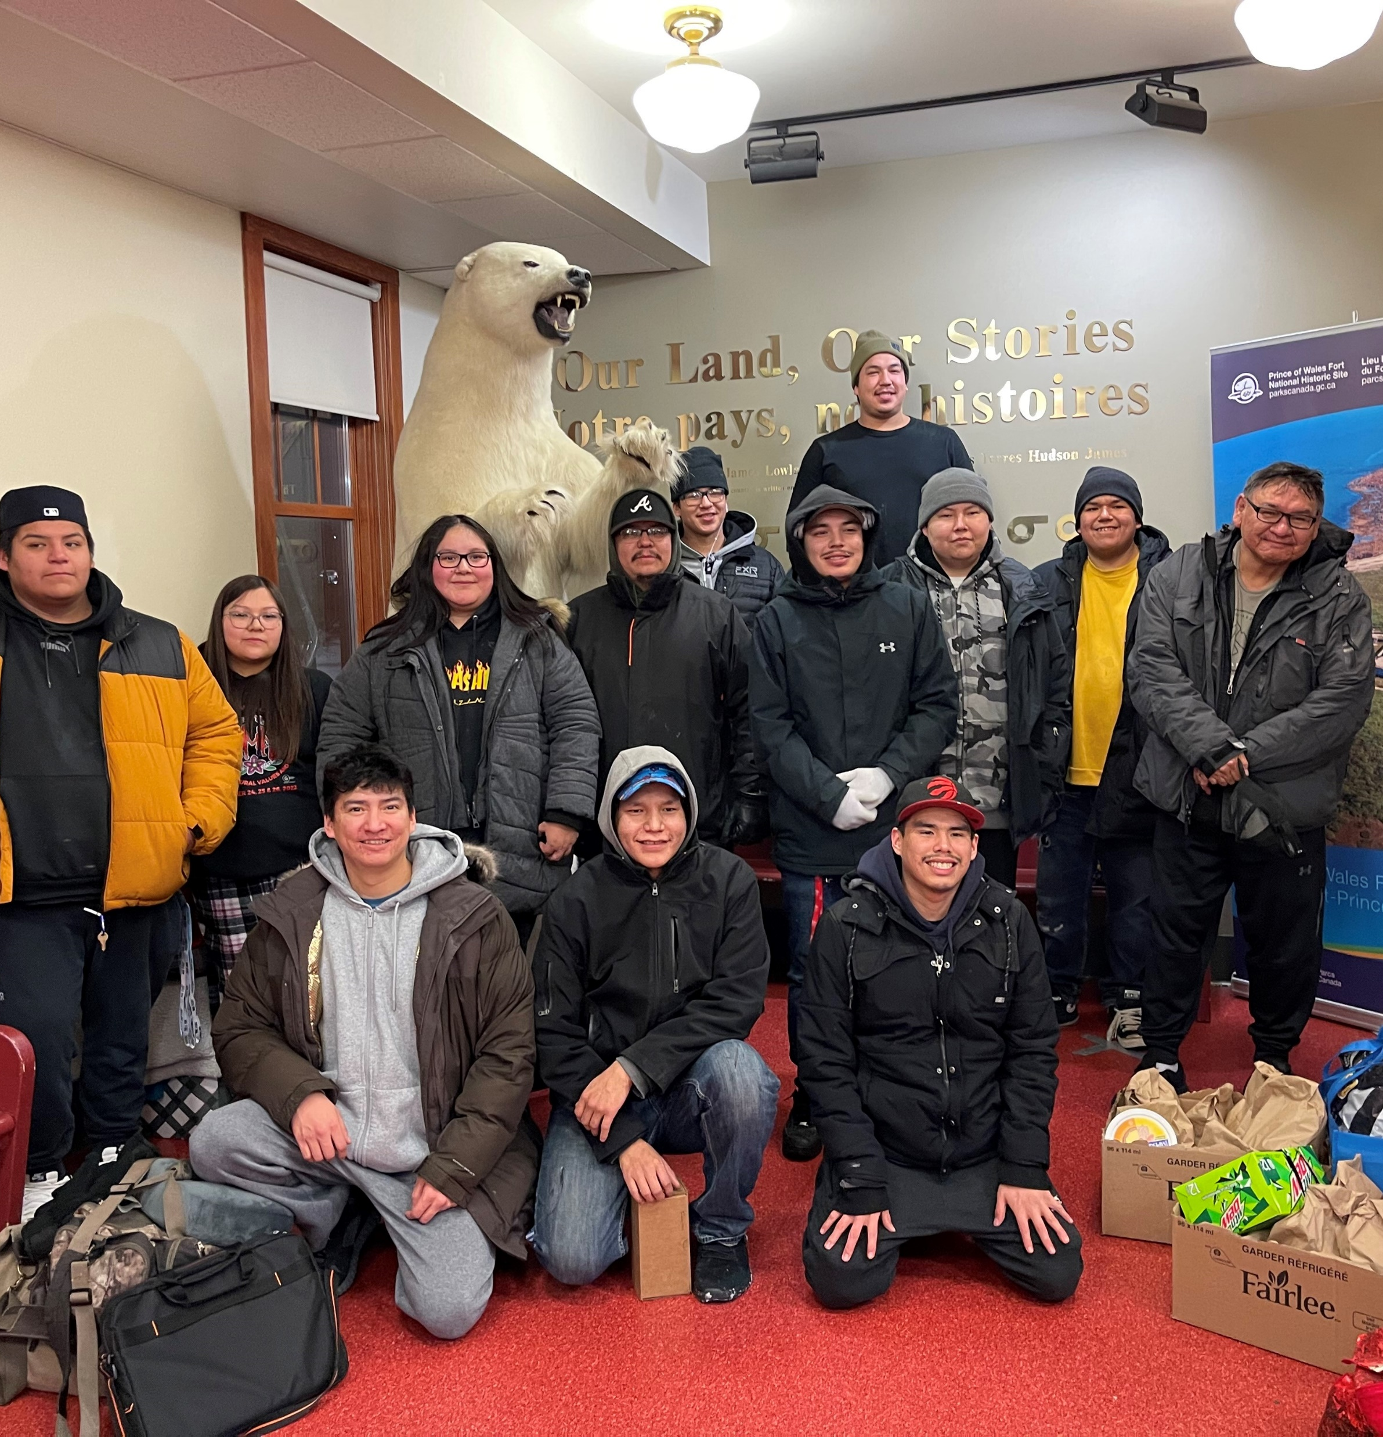
FUTURE ENGAGEMENT ACTIVITIES/EVENTS – 2023-2024
June 6-7, 2023 – CFS Chiefs Summit – Wyndham Garden, Winnipeg
June 28, 2023 – Winnipeg – Introductory - Off-reserve Engagement
July 4, 5, 6, 2023 – CFS Elders Gathering/Conference – Wyndham Garden, Winnipeg
July 24-27, 2023 – CFS Women’s Gathering – Wilderness Edge Resort, Pinawa
August 22, 23, 24, 2023 – CFS Engagement Conference – *Postponed to New Year*

Slide 21
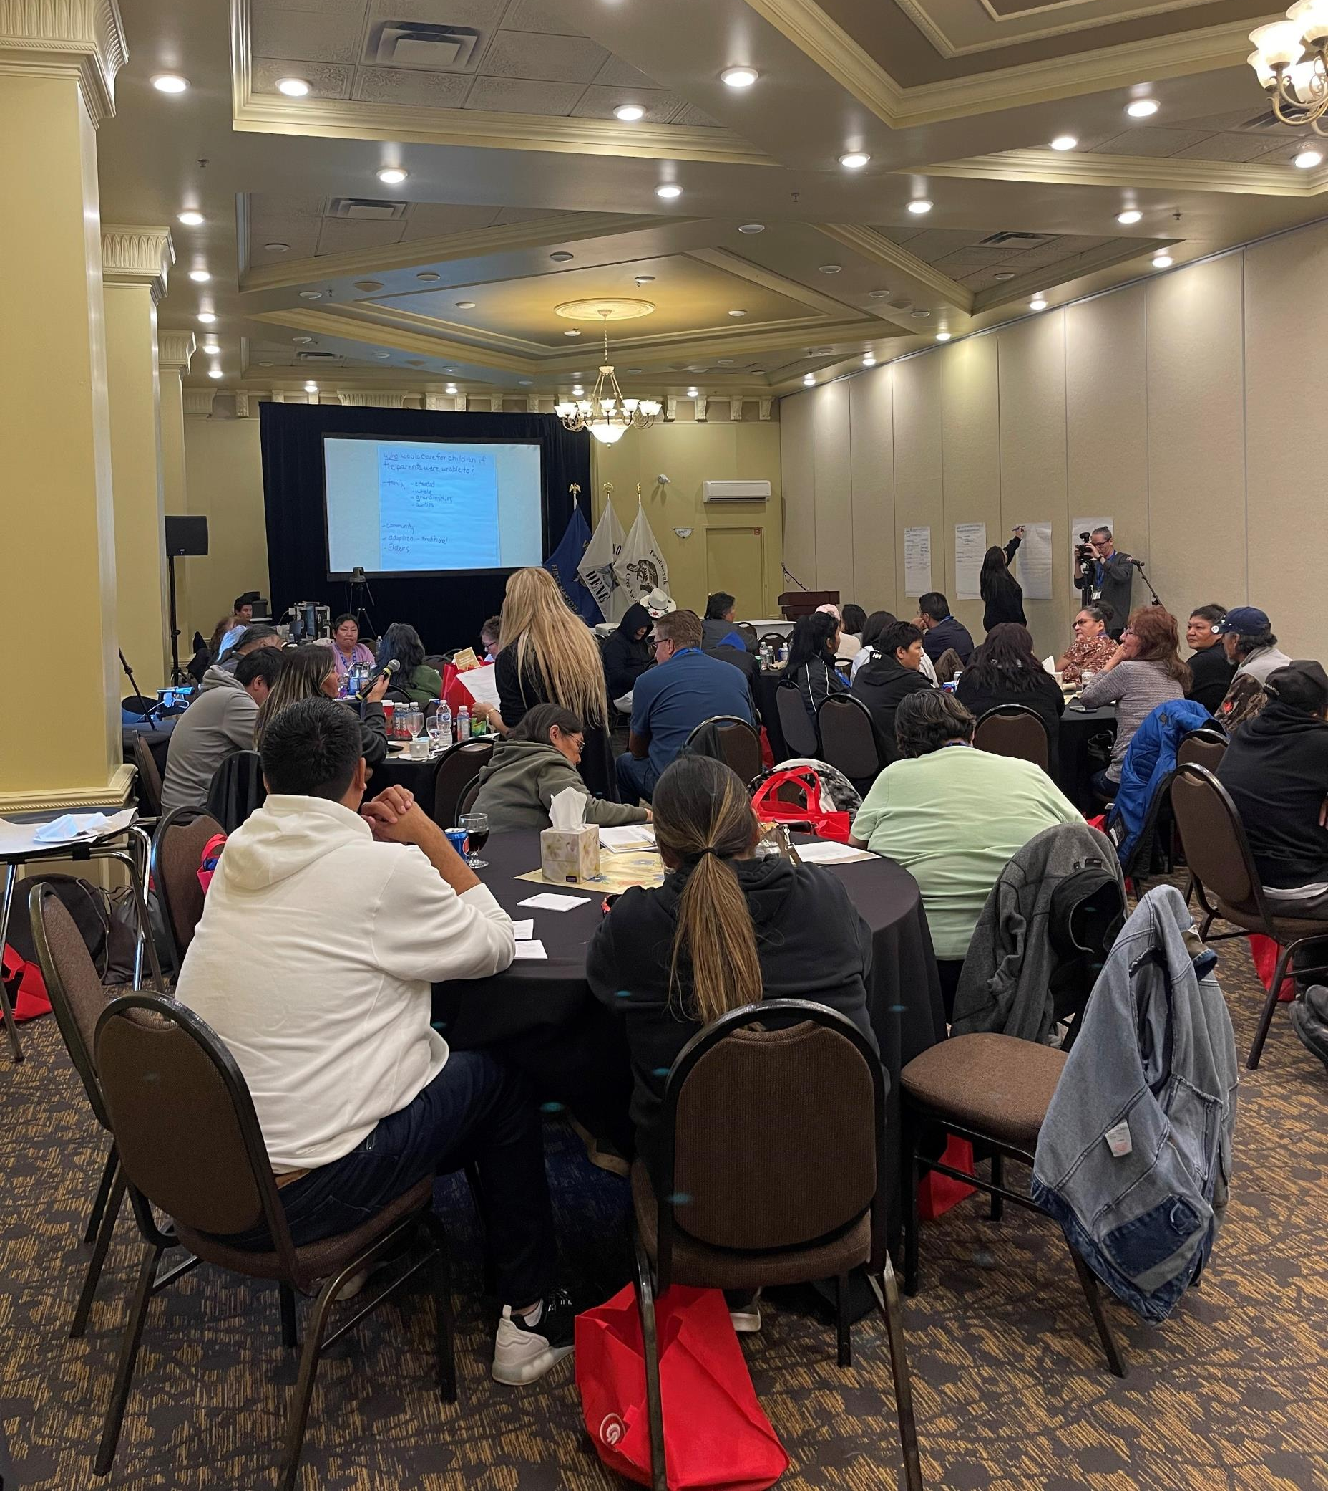
FUTURE ENGAGEMENT ACTIVITIES/EVENTS – 2023-2024
Ongoing Monthly CFS Committee Meetings
Sayisi Dene C. 24 (Bill C-92) Introductory Community Engagement
Ongoing Individual Engagement Sessions with all KTC Nations
Distribution of Information Packages to All KTC Nation members via Canada Post
Video Recorded Interviews with KTC Nation members:
  Previous Age-of-Majority Children-in-Care
  Families/Parents Affected by CFS
  Elders/Knowledge Keepers
  Women/Mother’s
  Other interested community members
2nd Annual Youth Engagement Gathering
On-going Off-reserve Member Engagements

Slide 22
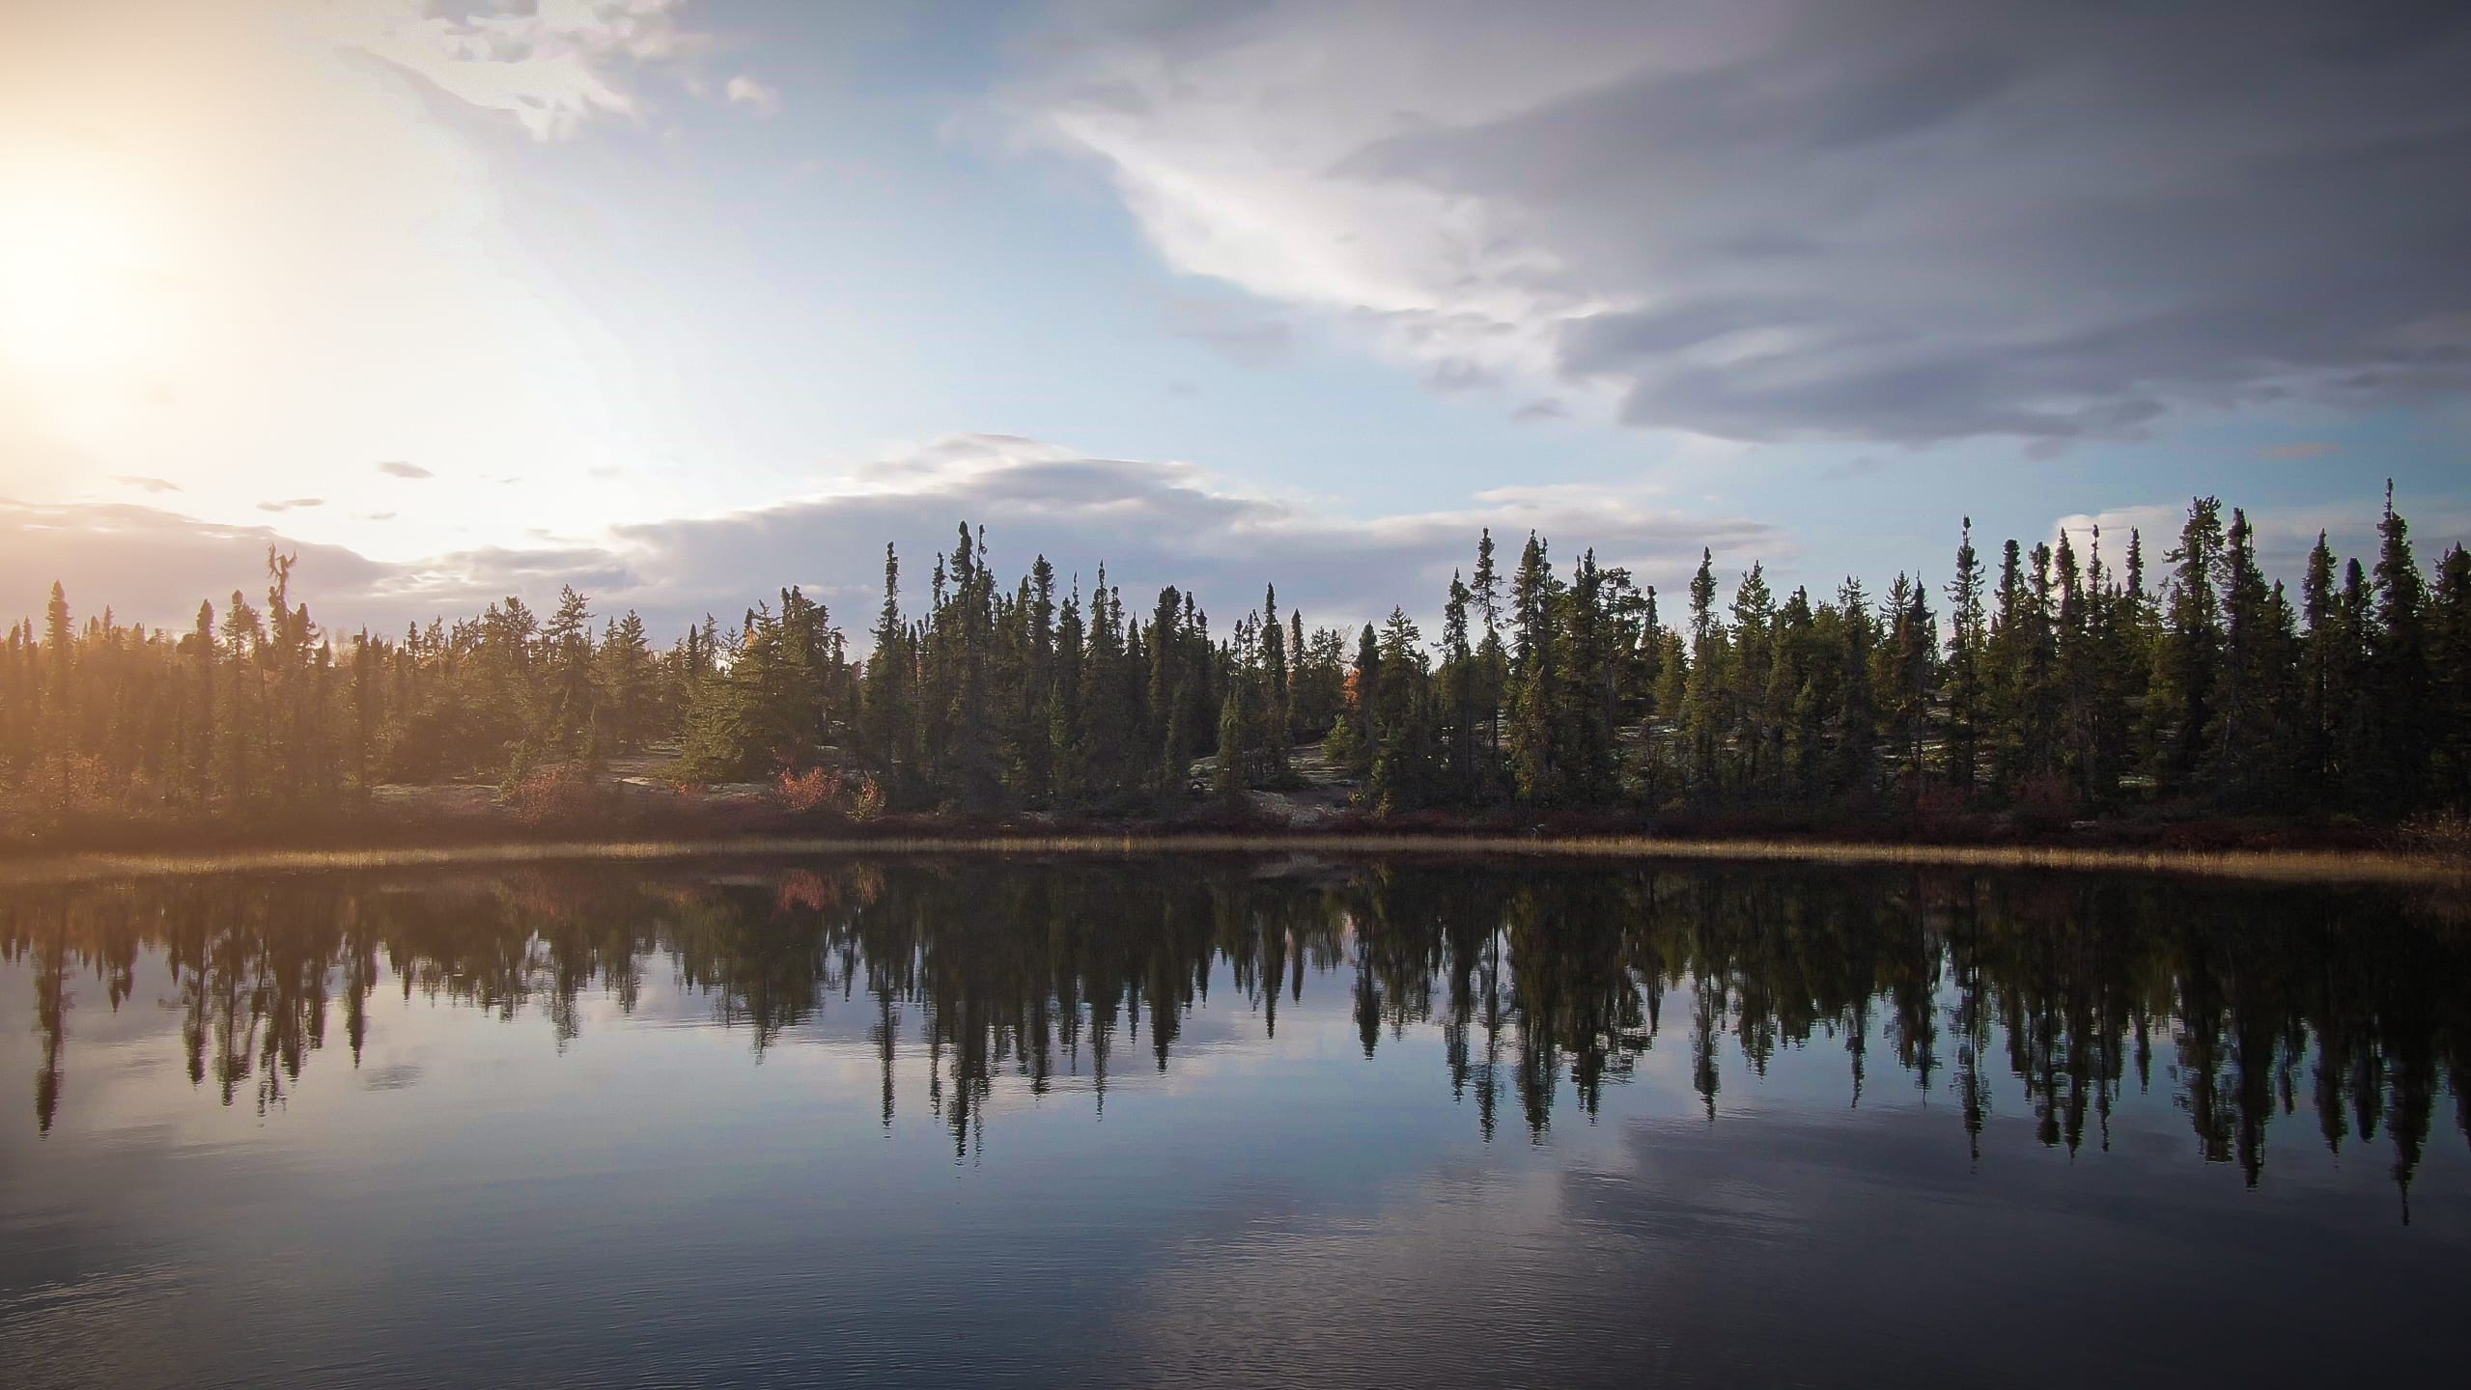
CONCLUSION
QUESTIONS?

