Slide 1
Technical Advisory Services Presentation
Keewatin Tribal Council Staff Development
May 17, 2023 – Thompson Legion

Slide 2
What is Technical Advisory Services
Technical Services was created at the same time KTC was started in 2004 once INAC (now Indigenous Services Canada) Thompson Branch was closed and handed over to KTC to lever all First Nations programs and services within its region.
Technical Advisory Service’s main role is to provide technical advisory services to our 11 KTC affiliated communities.
This includes housing, education, health, recreation and other infrastructure facilities and equipment at community level. Technical services also look after maintenance of water supply and drainage system (water/ waste water).
At its highest peak our department had as many as 6 Full time staff with a operating/project budget in its busiest year approximately $119,000,000.

Slide 3
WHAT WE MAINLY DO FOR ADVISORY SERVICES:
ADVISE ON HOUSING CONSTRUCTION TECHNIQUES, TYPES OF MATERIALS, COSTS, ETC.,
WORK WITH OUR 11 COMMUNITIES ON PROPOSALS TO BUILD SCHOOLS, TEACHERAGES, DAY CARE CENTRES, HOUSES, ETC.
WATER & SEWER INFRASTRUCTURE – REPAIRS, TRAINING, HOW AND WHERE TO OBTAIN PARTS, ETC.,
ENVIRONMENT-RECYCLING, END-of-LIVE VEHICLES (ELV)

Slide 4
Our Team Style
Linda Hunt
Steve Carnegie
Ellie Weenusk
Abdul Kahn
Nazzar Levasseur
I am in an Acting Director of Technical Advisory Services with over 25 years Housing & Property Management experience. I also have financial, management and administration expertise.
Steve is our go to guy as an Operations and Maintenance Technician, KTC; also holds Heavy Duty Certification with over 30 years experience.
We will be welcoming a new Admin Clerk in the next 2 weeks. If hired, She will bring with her financial, planning, and administration experience. She will be an effective staff member to our team.
Abdul is a certified registered professional planner (RPP) and has worked with KTC since 2008. He works on different assignments as community planning Advisor, Proposal writer and as a Coordinator to our capacity programs.
Ivan brings 10 years of Fire Prevention and Protection experience. He is always willing to work with KTC and currently just finished Installation of 600 Fire Guard Shields in our communities

Slide 5
Departmental Division
Projects
Housing & Infrastructure for 11 Communities
Areas of Technical Work
Fire
Fire Protection and Services for 11 KTC communities
Technical Advisory Services
Housing
Construction & Renovations for 11 Communities
Environmental/Climate Change

Slide 6
Housing
Tribal Housing Advisor

Slide 7
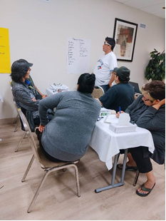
Since starting the position of Housing Advisory Services in July, 2022 I have been responsible for MIHCEMI housing program for all 11 communities of KTC. There are outstanding reports for all 11 communities and I am working with each Housing Manager to get these completed. The biggest challenge is obtaining the financials from each finance department
Other outstanding reports are Construction and Renovation dollars funded to our 11 communities. There are a lot of funding dollars to be reported to ISC and they will be withholding funding if these reports are not completed and submitted to ISC.

Slide 8
One of the key areas the Tribal Housing Advisor will concentrate on is bringing in the expertise at the next workshop series and assisting the communities in how to complete construction toolkits and complete housing reports. WE DO NOT NEED FUNDING HOLDBACKS! WE NEED HOUSES FOR OUR COMMUNITIES!

Slide 9
OPERATIONS & MAINTENANCE (O&M)
Operations & Maintenance Technician – Steve Carnegie

Slide 10
Role & Functions
Operations & Maintenance Technician
Content Here
The primary function as O&M Technician is to:
Prepare and oversee the preparation of reports and statistics for ACRS and CAIS.
Assist with training and development programs for community O&M staff.
Assist First Nations to develop and implement schedules and procedures for safety inspections and maintenance management systems and plans.
Repair, replacement and renewal of failed infrastructure elements.
Investigate mechanical failures or unexpected maintenance problems.
Tech Services, when they can, assist First Nations to plan and manage their O&M budget.
Content Here
Text

Slide 11
One of the expectations of KTC from the community level is we cover everything….for example,
Tech Services often gets emergency calls for water & sewer problems and this is on a consistent basis. In the 5 months alone we have had to send Steve into 3 communities to tend to WTP broken down, no potable water, or lift station problems.
Our area of concern is KTC has to pay for the expense of those repairs and we struggle to re-coup the money from ISC or the First Nation. For example, we spent approximately $225,000 and it comes from the Tech Services pockets if they are not paid back.
This one area is one of our priorities and biggest financial challenge
Operations & Maintenance ~ Steve Carnegie

Slide 12
Projects – 11 KTC Communities
A/Director of Technical Services, Housing & Infrastructure – Linda Hunt

Slide 13
Role & Functions
Director of Technical Advisory Services – Housing & Infrastructure
The primary function as Director is to plan, organize, direct, and control the Community and Technical Services department. It consists of, at this time, 2 advisory services staff and 1 support staff.
In addition, the position performs direct advisory service activities in the social, financial, economic, and governance areas when required, along with other relevant duties as assigned and directed by the CEO. These are identified in quarterly activity reports (new).

Slide 14
Just to give you an example of our many projects that are ongoing or to the completion stage, here are our top 6 and they are;
Bunibonibee New & Existing Landfill Project - $9 Million
God’s Lake New & Existing Landfill Project - $9 Million
Barren Land’s Soil Remediation Project - $7.4 Million
Shamattawa New Subdivision - $ 5.4 Million
Shamattawa Teacherage - $ 6.4 Million
Shamattawa Environmental Site Assessments - $ 1Million
These projects we oversee the project, management, operations, and ensure inspections are met to the completion of the individual projects.
Our project management fees are nomimal. If other project management companies oversaw these projects they would receive hundreds of thousands of dollars vs. $50 K we receive on one project alone. This is the expectation from ISC for KTC to run on empty pockets. We are addressing this currently.

Slide 15
Role & Functions - Abdul Kahn
Comprehensive Community Planning
Abdul is undertaken discussion with York Factory First Nation in this endeavor to complete over the next year..
Community Planning Advisor
Manitoba Affordable Housing Initiative
Working closely with the Province of Manitoba on a 3 million dollar housing project.
Community Based Climate Monitoring
Effect of Permafrost on Infrastructure in 3 communities and monitoring effect of climate change on social behavior in 4 communities.
Indigenous Community Based-Climate Monitoring
Proposal Writer
You can simply impress your audience and add a unique zing and appeal to your Presentations.
Derelict Vehicle Scrap Metal Collection
This End of Life (ELV) project has completed in 8 communities so far. We will continue program for 20.23-20.24 period.
Fire Equipment
Proposal work submitted to assist 11 KTC communities for Fire Protection and Fire Equipment

Slide 16
Capacity & Skills Development
Training & Workshops Past and Present
CMHC Workshop Series
Tech Services completed 4 workshops in 2023 under the MIHCEMI ISC initiative. We will continue to network and have workshops to improve knowledge and experience in housing.
ISC Housing Workshops
Tech Services also continues to access funding from ISC for more training dollars for additional workshops for our 11 housing managers.
Asset Management Training
Phase II implementation for 11 communities under the Circuit Rider Project to initiate and prepare each community for their AMP plan.
Land Use Planning Certificate Training
Created a workshop for Trainees from our 11 communities to get certified in Land Use Planning.

Slide 17
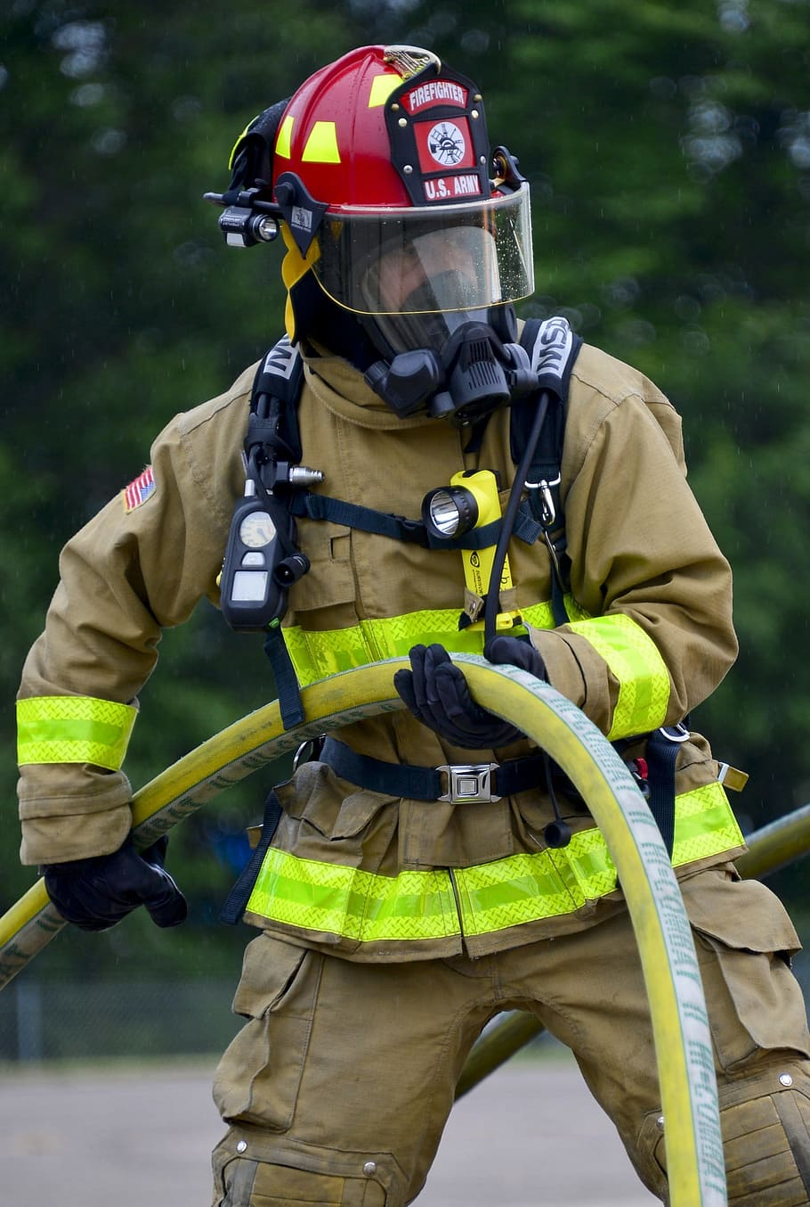
Other - Fire Protection
Content Here
You can simply impress your audience and add a unique zing and appeal to your Presentations
Content
Content Here
Text
Your Content Here

Slide 18
EXISTING SITUATION IN
REMOTE FIRST NATION COMMUNITIES
For example, we continue to struggle with gaps in the effectiveness of the current community maintenance programs, resulting in increased emergency repairs and/or recapitalizations.
Lack of Training
Lack of Maintenance Programs
Recapitalization

Slide 19
The Biggest Challenges
Since the budget cuts in 2014 has greatly decreased the workforce load of Tech Services department. We need to find a talented composition we once had. Engineers, Inspectors, Red Seal Carpenters in different position, Electricians. We need these tradespeople and expertise
Some other Challenges are:
Our 11 Communities expect the same services prior to cuts of 2014 i.e. lack of inspections that buildings require a various stages
No full time Engineer we once had in our department.
Our fire support services are no longer. We contract on as need bases and basically no funding.
Tech services still expected to function and provide the role that it was originally established to do.
Construction Toolkits are not being completed and this is causing ISC funding to be withheld ($43 Million)
Need more capacity development dollars for training.
The Need for a Full-time Fire Safety Officer.
THE
REALITY

Slide 20
THANK YOU
From the Technical Services Team !

